Slide 1

TECH TUNES A MODERNISED Music Search Engine
Dive into the symphony of music

Slide 2
Members
Manan Dalal(MUD200000)
Lipi Patel(LDP210000)
Namrata Thaker(NDT200003)
Akash Ramani(AXR200012)
Fenil Godhani(FKG210000)
Yash Shingvi(YXS210018)
Yash Kolhe(YSK210001)
Nishant Ramani(NXR200011)
Nischal Sudeep(NTS200000)

Slide 3
OUR TEams
Front End
Manan Dalal
Nishchal Sudeep
Yash Kohle
Back End
Namrata Thaker
Manan Dalal
Yash Shingvi
Web Scraping
Yash Shingvi
Lipi Patel
Namrata Thaker
Documentation
Lipi Patel
Fenil Godhani
Akash Ramani
Nishant Ramani

Slide 4

AIM
To create an optimized search engine system that retrieves information from the internet, based on the search query that the user entered.
01
To focus on a specific domain of information and provide efficient and best results confined to the knowledge space of that domain.
02
To make the process for retrieving information as easy as possible for non-technical users.
03

Slide 5
Domain: Music
Tech Tunes only focuses on the domain of Music. We have considered the attributes like song name, singer name, genre, best playlist of 2021 and so on.
Tech Tunes is a simple and quick responsive search engine which will be user friendly.

Slide 6
Functional Requirements
Case insensitive search
Hyperlink enforcement
Specifying OR/AND/NOT Search
Concurrent Operation
Deletion of out-of-date URL
Listing of the query result in ascending alphabetical order and popularity.
Most frequently search query
Setting the number of results to show per page, and navigation between pages
Autofill, while correcting typographical errors
Filtering out symbols that are not meaningful, according to the user configuration

Slide 7
Non-Functional Requirements
User Friendly: It should be easy to understand
Portable: Search Engine should be able to run on any system
Enhancive: Can add new features and functionality as time goes
Responsive: The search engine should give results within a few milliseconds
Adaptive: It should be able to adapt any new changes in system without affecting any other functionalities.
Concurrency: More than one user can be able to access the search engine simultaneously.

Slide 8
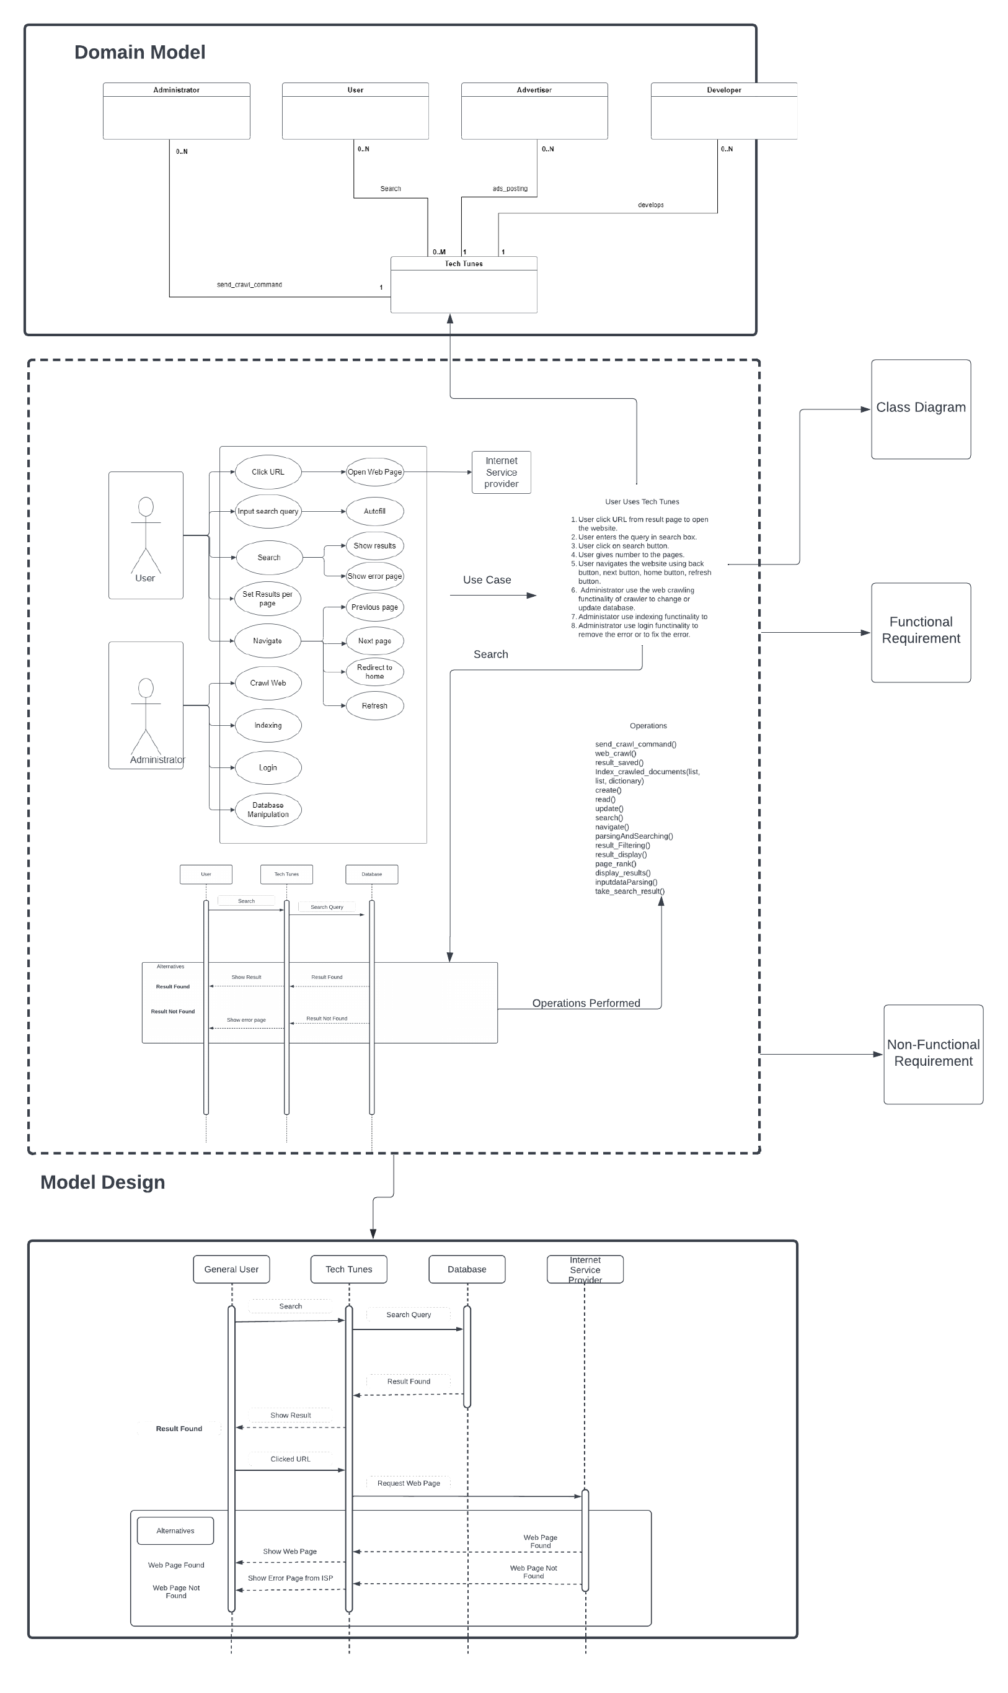
Big picture diagram

Slide 9
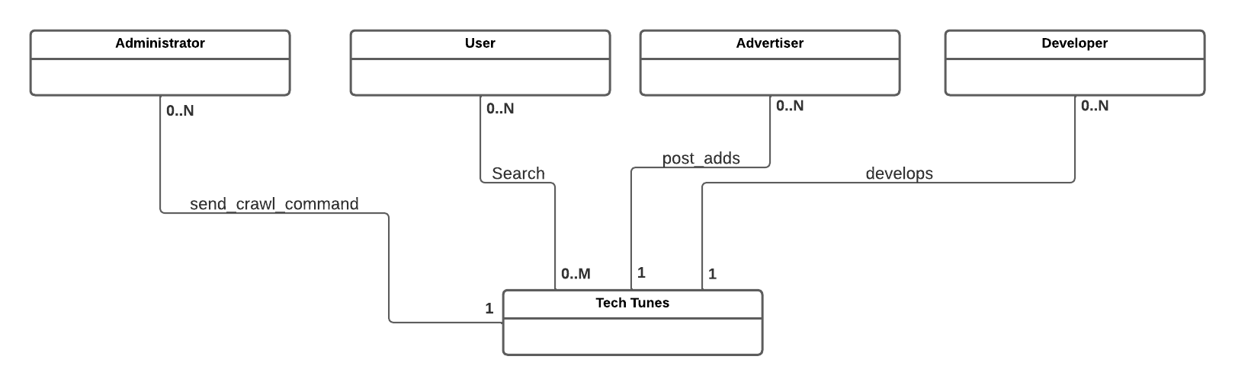
Domain model diagram

Slide 10
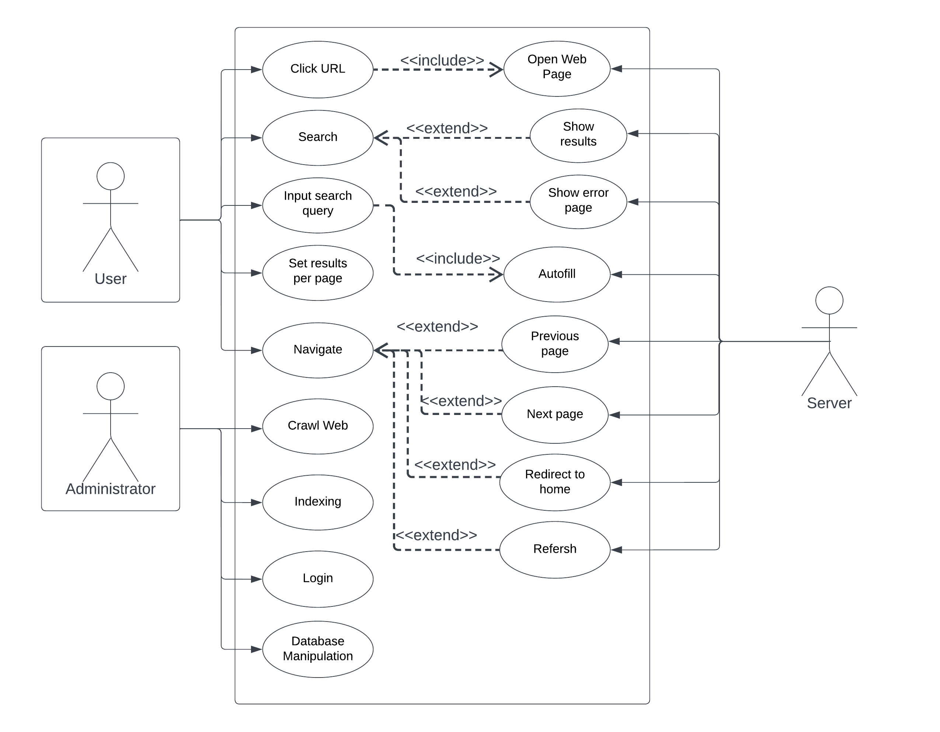
USE CASE DIaGRAM

Slide 11
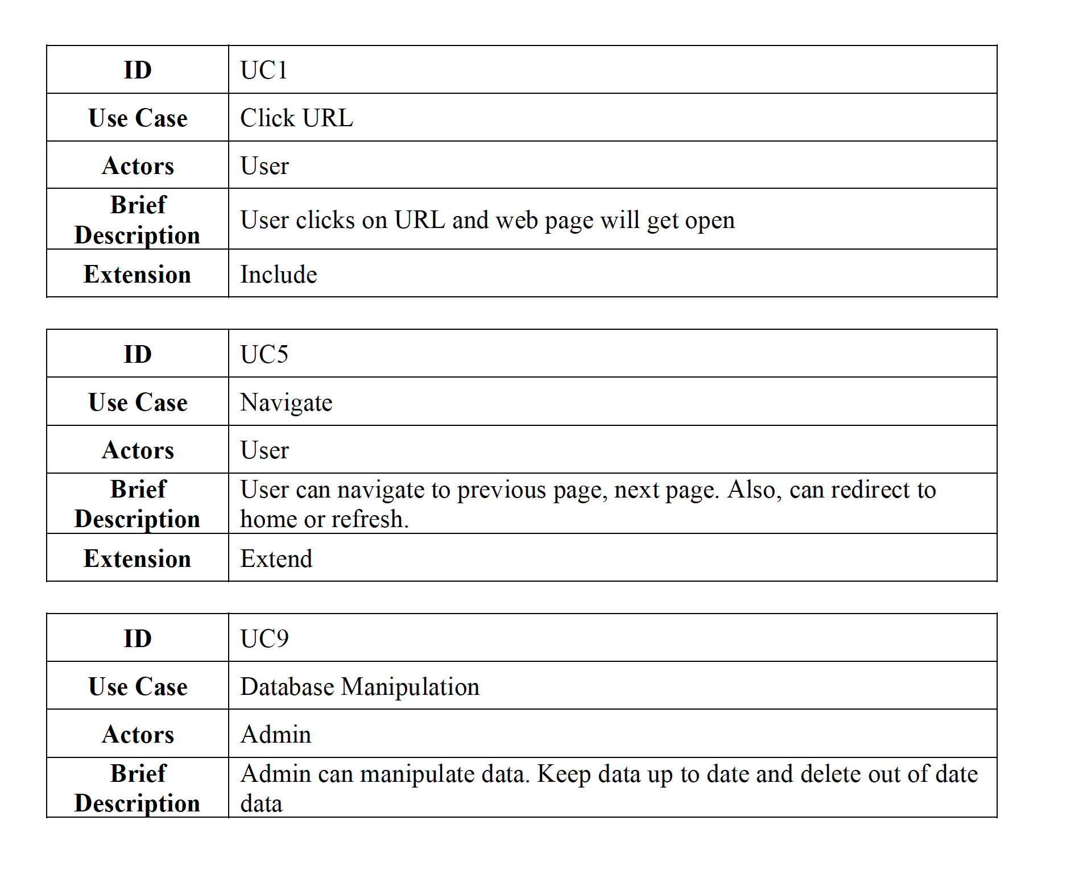
USE CASE Template

Slide 12
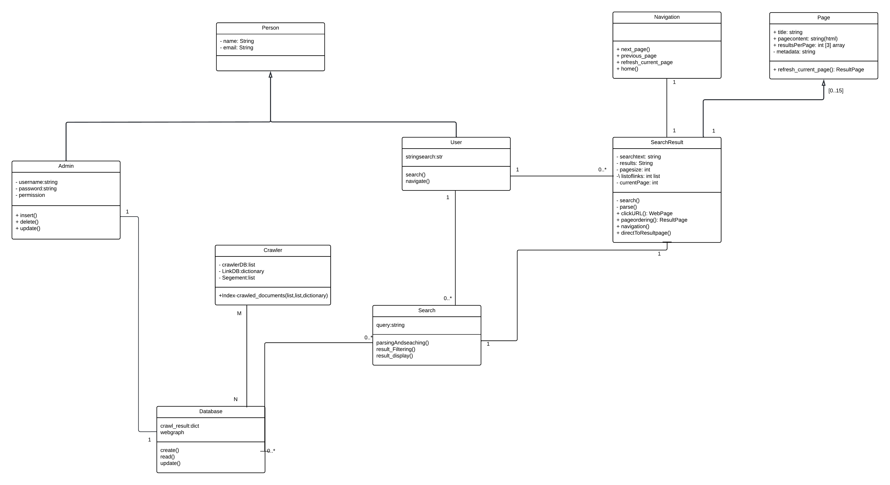
Class Diagram

Slide 13
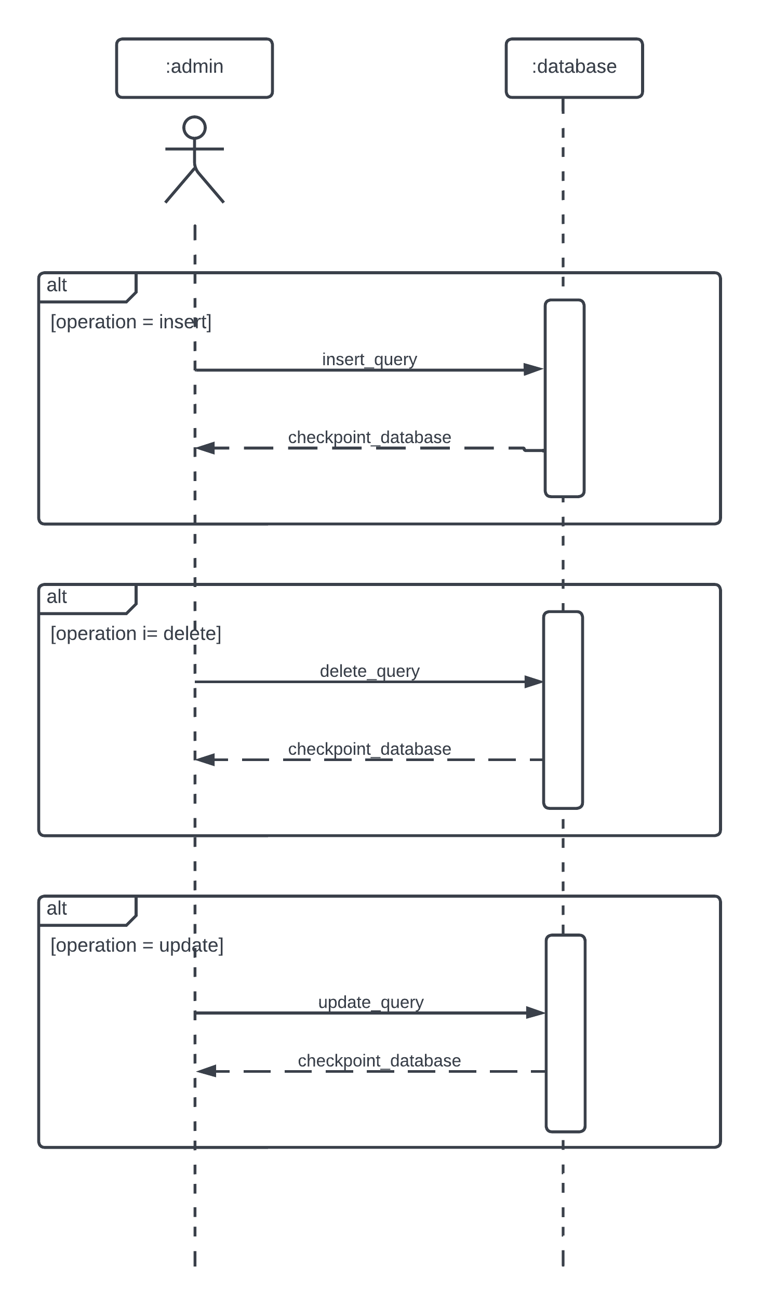
Sequence diagram: aDMIN

Slide 14
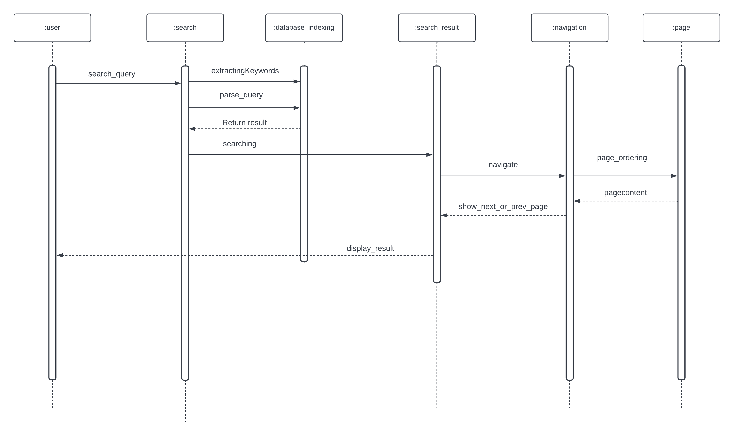
Sequence diagram: user search

Slide 15
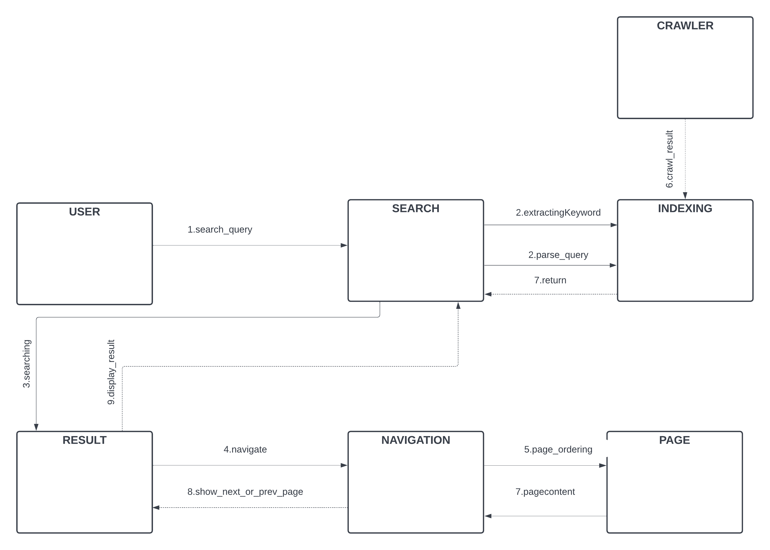
Collaboration Diagram

Slide 16
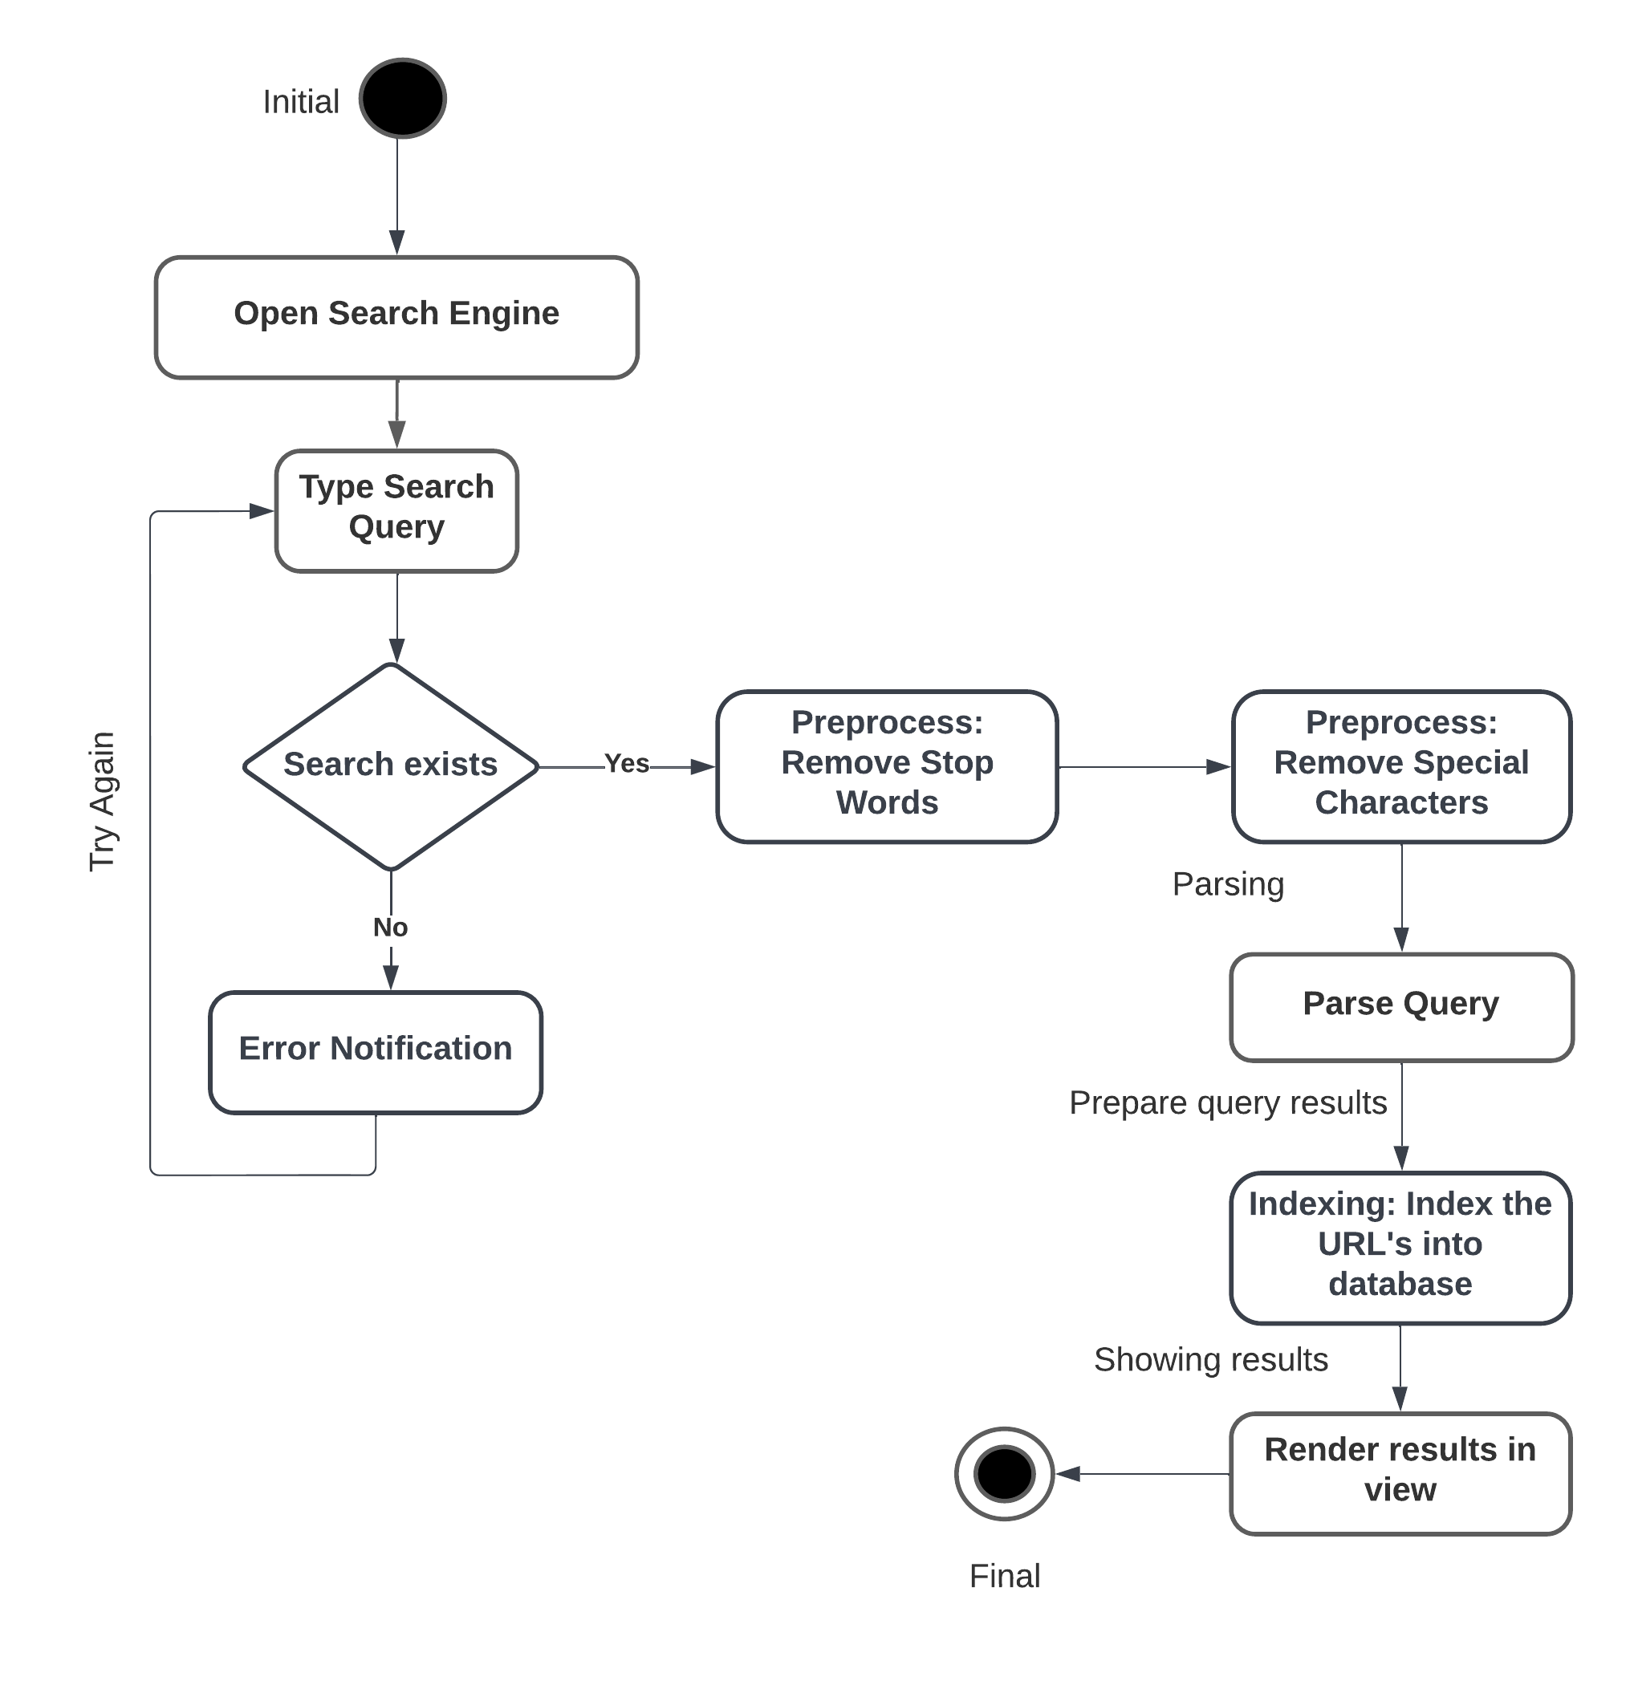
State Transition Diagram

Slide 17
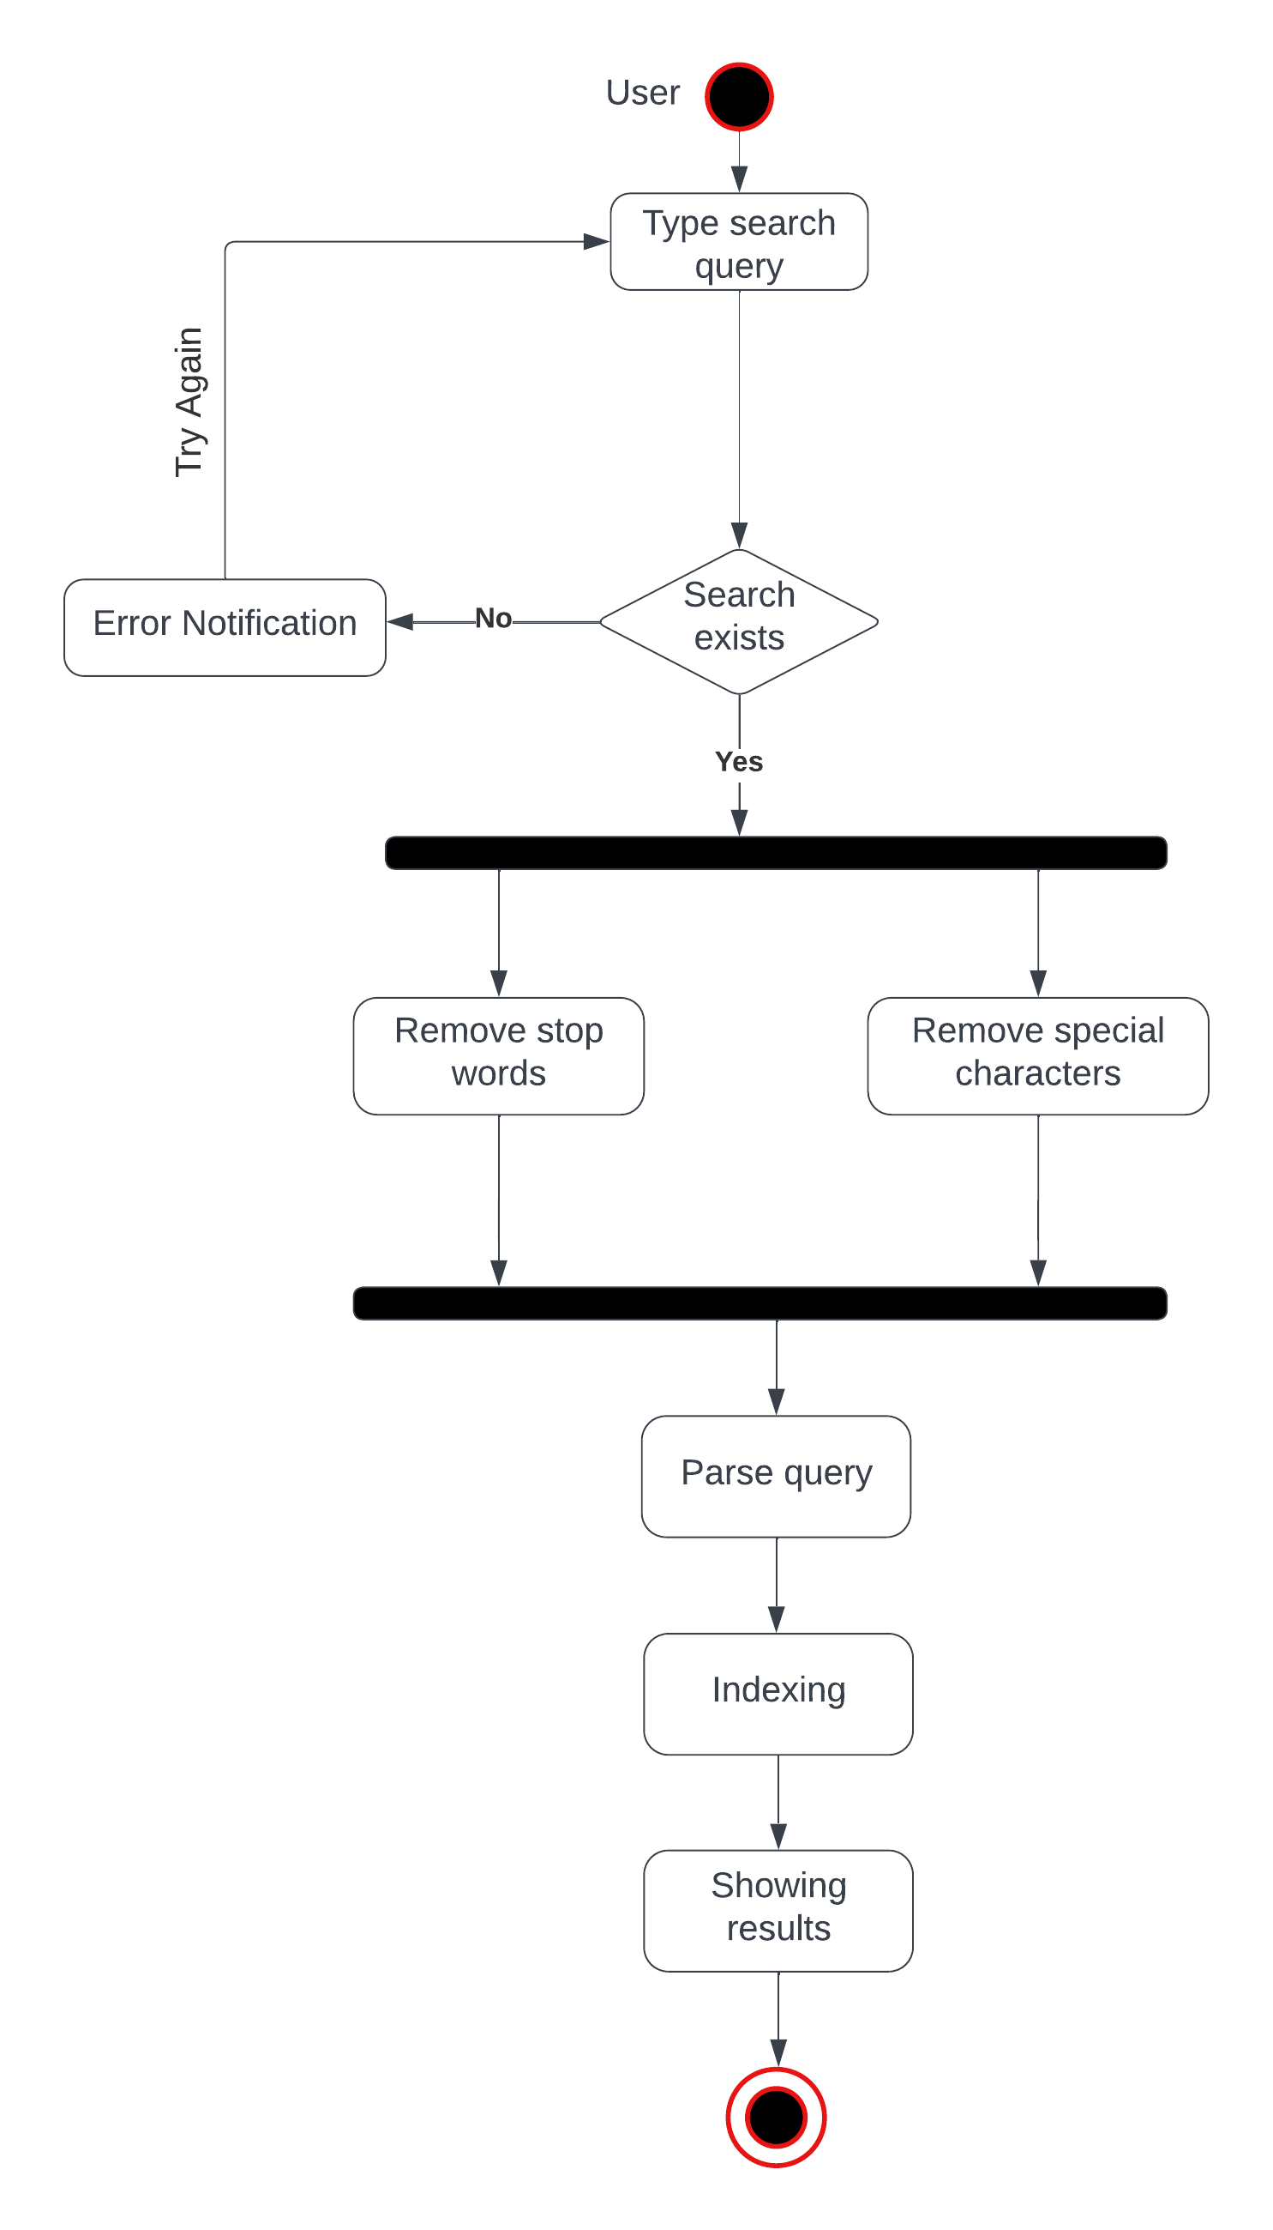
Activity Diagram

Slide 18
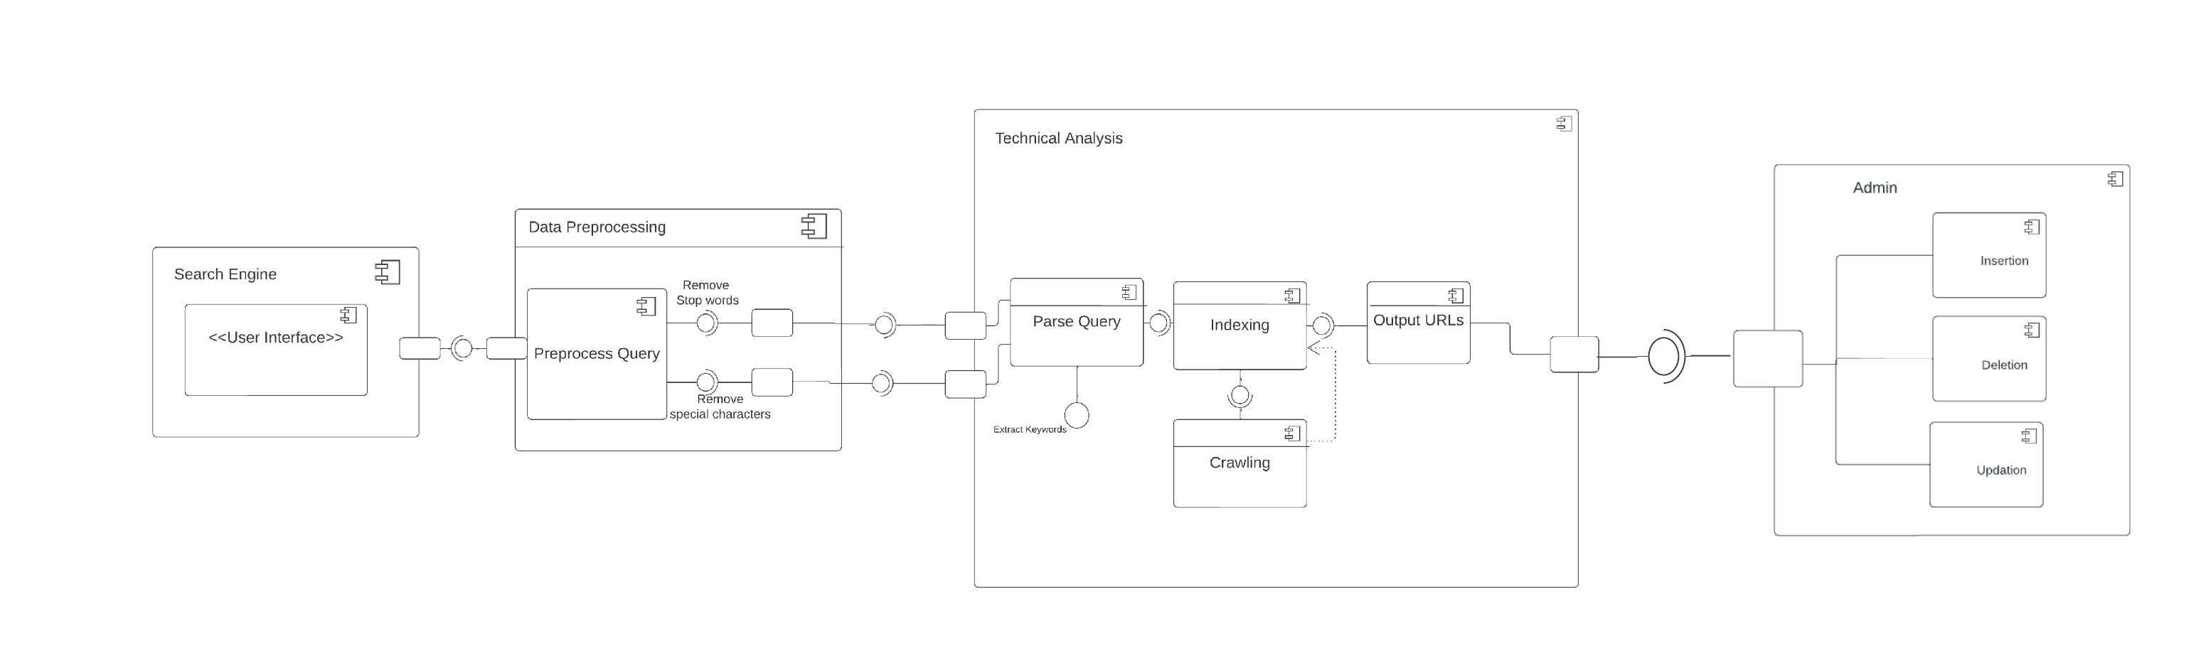
Component Diagram

Slide 19
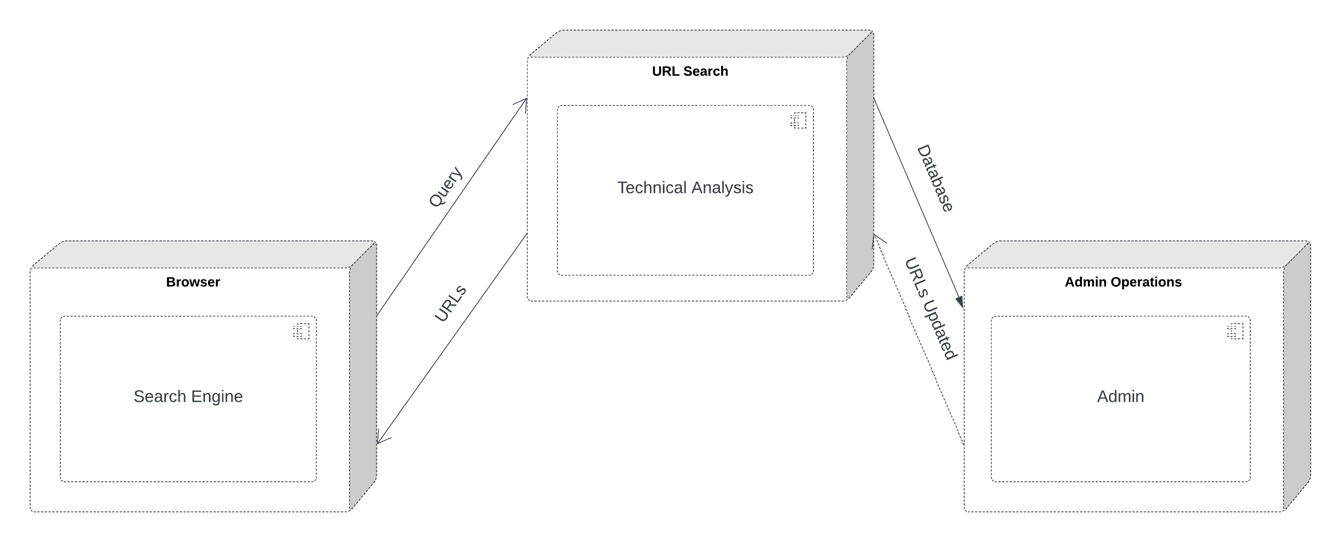
Deployment Diagram

Slide 20
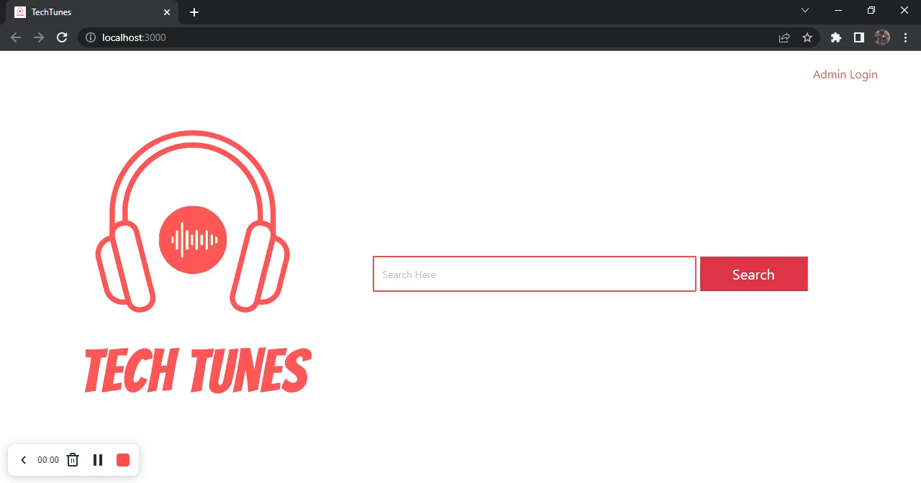
Demo

Slide 21
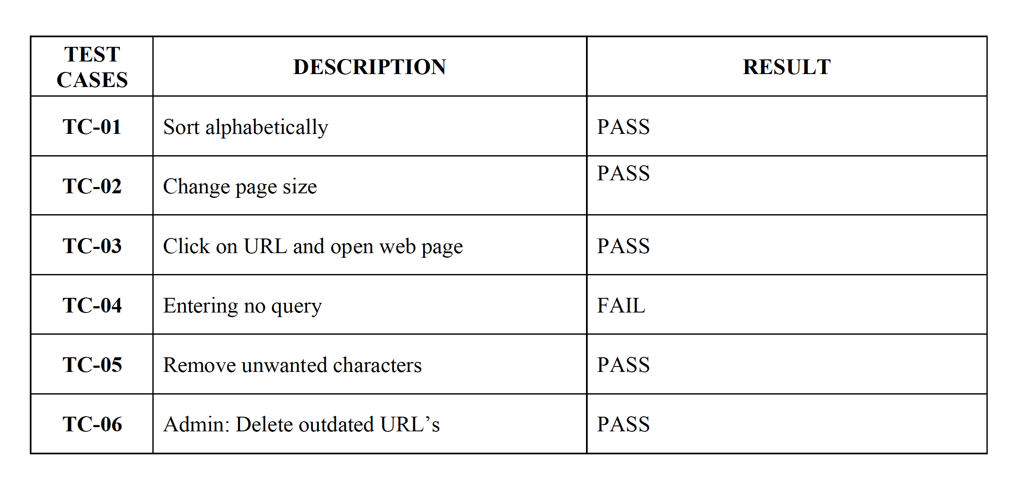
Test Cases

Slide 22
THANK YOU

